Slide 1
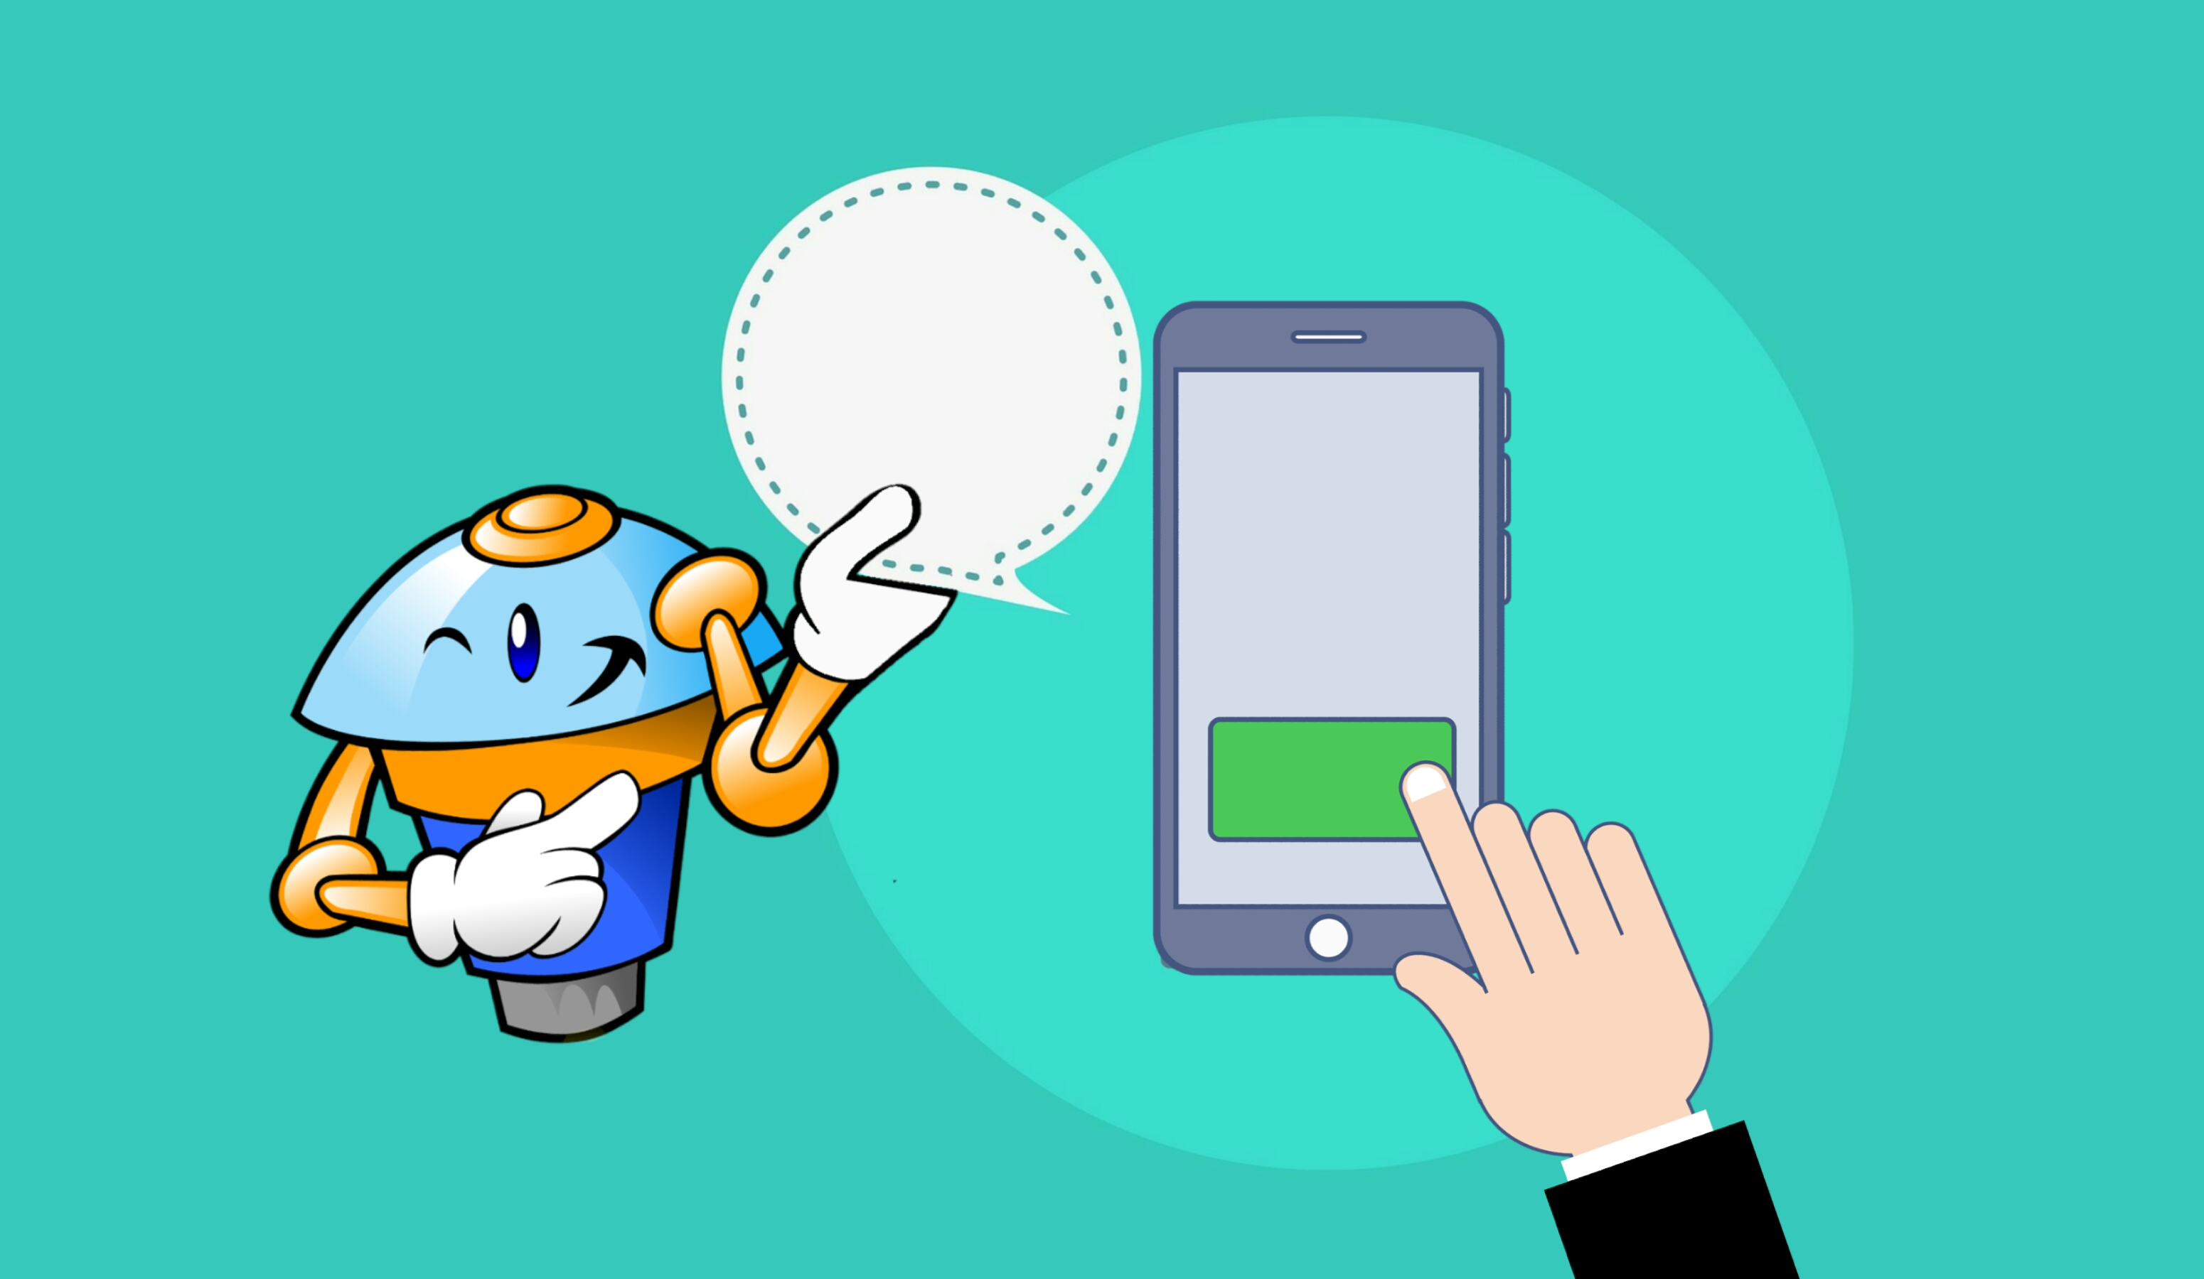
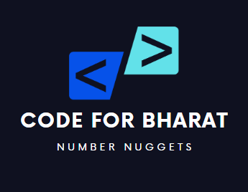
Code for Bharat: Number Nuggets
DELIVERS DAILY TRIVIA TIED TO MATH, DATES, OR FUN NUMBER FACTS TO MAKE NUMERACY MEMORABLE.
TEAM_5 Members:
Alok Diwan
Ashwini Badge
Suraj Dhase
Shruti Rani
Abhishek Jagtap
Preeti Natekar
Sandip Sannyasi
Avishek Sinha

Slide 2

Table of Contents
Section 1 | Summary | Slide No. 3
Section 2 | Background & Context /Problem Statement | Slide No. 4
Section 3 | Analysis and Workflow | Slide No. 6
Section 4 | Demo | Slide No. 7
Section 5 | Appendix | Slide No. 8

Slide 3

Summary
For many students, numbers feel like lifeless equations things to memorize, not explore. But what if we could breathe wonder into math by connecting numbers to stories, science, and surprises?
Number Nuggets is a chatbot that turns every number into a fascinating fact. Whether it's the birthday of a freedom fighter, the distance between Earth and Mars, or a quirky math property, the bot delivers one intriguing nugget a day - transforming numeracy into an adventure.
Designed for middle and high school learners, this idea turns dry digits into memorable experiences. With a conversational interface and trivia-style interaction, it helps students build number sense, cross-subject awareness and a lasting sense of curiosity.

Slide 4

Background & Context /Problem Statement
Explore by Number
Let users type in or click a number of interest number. like their birthday, roll number, or a random number
The bot responds with a matching fact, like: "15- The number of languages in the Indian currency note!
For bonus points, allow users to favourite numbers or facts they love.
Surprise Me Mode
Add a playful "Surprise Me" button to generate a completely random fact.
This supports curiosity-driven learning and keeps the experience fresh.
Fact of the day
Optionally link the number to the current date "Today is May 14 (Day 134 of the year). Did you know the secret meaning of number 134 tells you to embrace positive energy going forward.
Combine this with "Today in History" for cross-concept links between time and math.

Slide 5
Background & Context /Problem Statement
Desired Impact
Numeracy Engagement: Transform passive arithmetic into curiosity-led exploration through daily play Interdisciplinary Thinking:
Connect math to science, culture, history, and language Memory & Recall:
Use surprise and delight to make numerical facts stick Equity in Access: Provide a lightweight, mobile-friendly learning tool for all types of learners Cognitive Confidence:
Help students develop a positive emotional connection with numbers

Slide 6

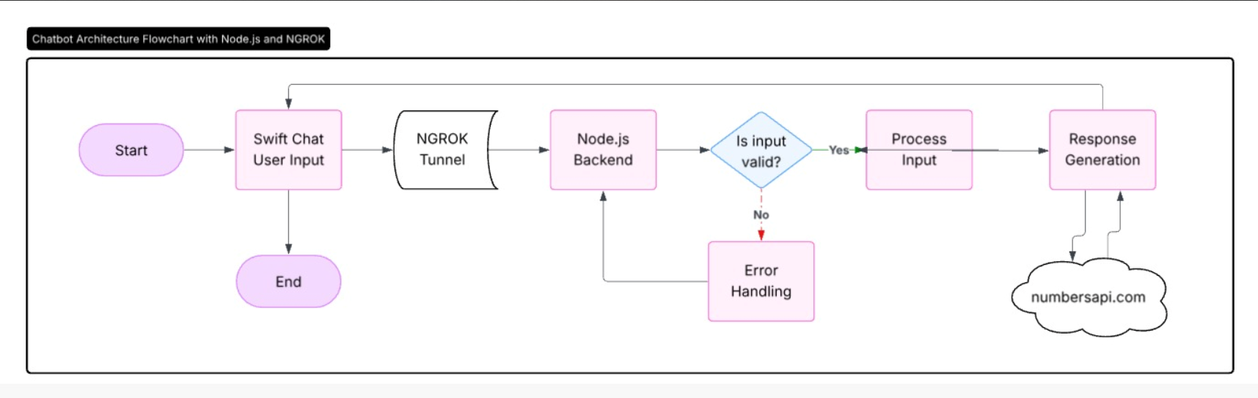
Analysis and Workflow
Code Reference:
SwiftChat Lite
Get started with swiftchat — SwiftChat-Development-Guide 0.1 documentation

Slide 7

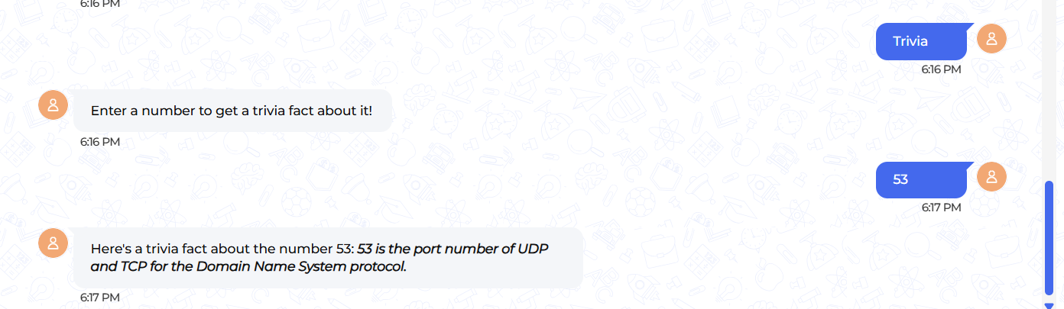
Final Outcome

Slide 8
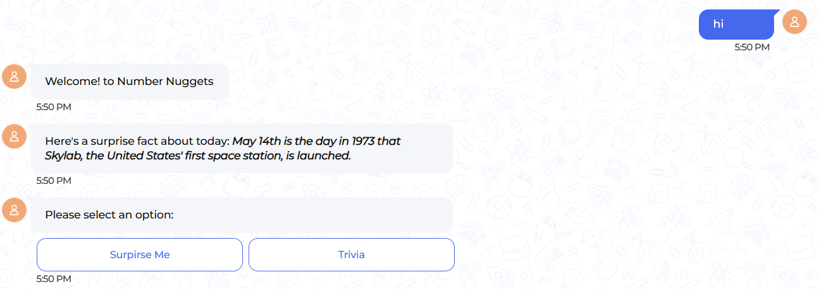
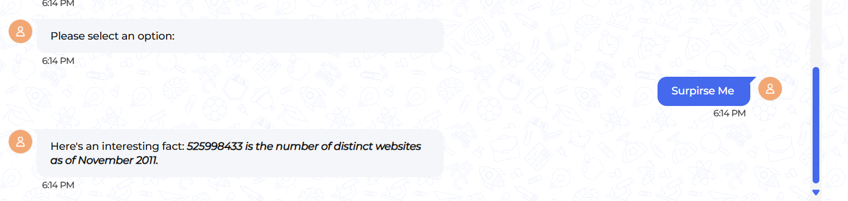
Final Outcome

Slide 9

References
GitHub - Code4Bharat-2025/demo
http://numbersapi.com/

